Slide 1
Tight bounds
on sparse perturbations of Markov Chains
Romain Hollanders
Giacomo Como
Jean-Charles Delvenne
Raphaël Jungers
UCLouvain
University of Lund
MTNS’2014

Slide 2
PageRank is the average portion of time spent in a node
During an infinite random walk

Slide 3
PageRank is the average portion of time spent in a node
During an infinite random walk

Slide 4

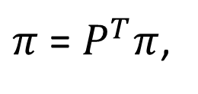
PageRank is the average portion of time spent in a node
During an infinite random walk
PageRank :
$π$ = $P^{T}π$,
$$1^{T}π=1$$

Slide 5


How much can a few nodes affect the PageRank values ?
PageRank :
$π$ = $P^{T}π$,
$$1^{T}π=1$$

Slide 6

How much can a few nodes affect the PageRank values ?
$$𝓦$$
PageRank :
$π$ = $P^{T}π$,
$$1^{T}π=1$$

Slide 7
How much can a few nodes affect the PageRank values ?
$$𝓦$$
PageRank :
$π$ = $P^{T}π$,
$$1^{T}π=1$$

Slide 8




How much can a few nodes affect the PageRank values ?
$$𝓦$$
$$\sim$$
$$\sim$$
$$\sim$$
$$\sim$$
PageRank :
$π$ = $P^{T}π$,
$$1^{T}π=1$$

Slide 9



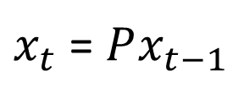
How much can a few nodes affect a consensus ?
Consensus :
$x_{t}$ = $Px_{t−1}$

Slide 10


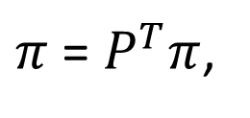
How much can a few nodes affect a consensus ?
the weight of each agent in the final decision
Consensus :
$π$ = $P^{T}π$,
$$1^{T}π=1$$

Slide 11




How much can a few nodes affect a consensus ?
$$𝓦$$
$$\sim$$
$$\sim$$
$$\sim$$
$$\sim$$
Consensus :
$π$ = $P^{T}π$,
$$1^{T}π=1$$

Slide 12
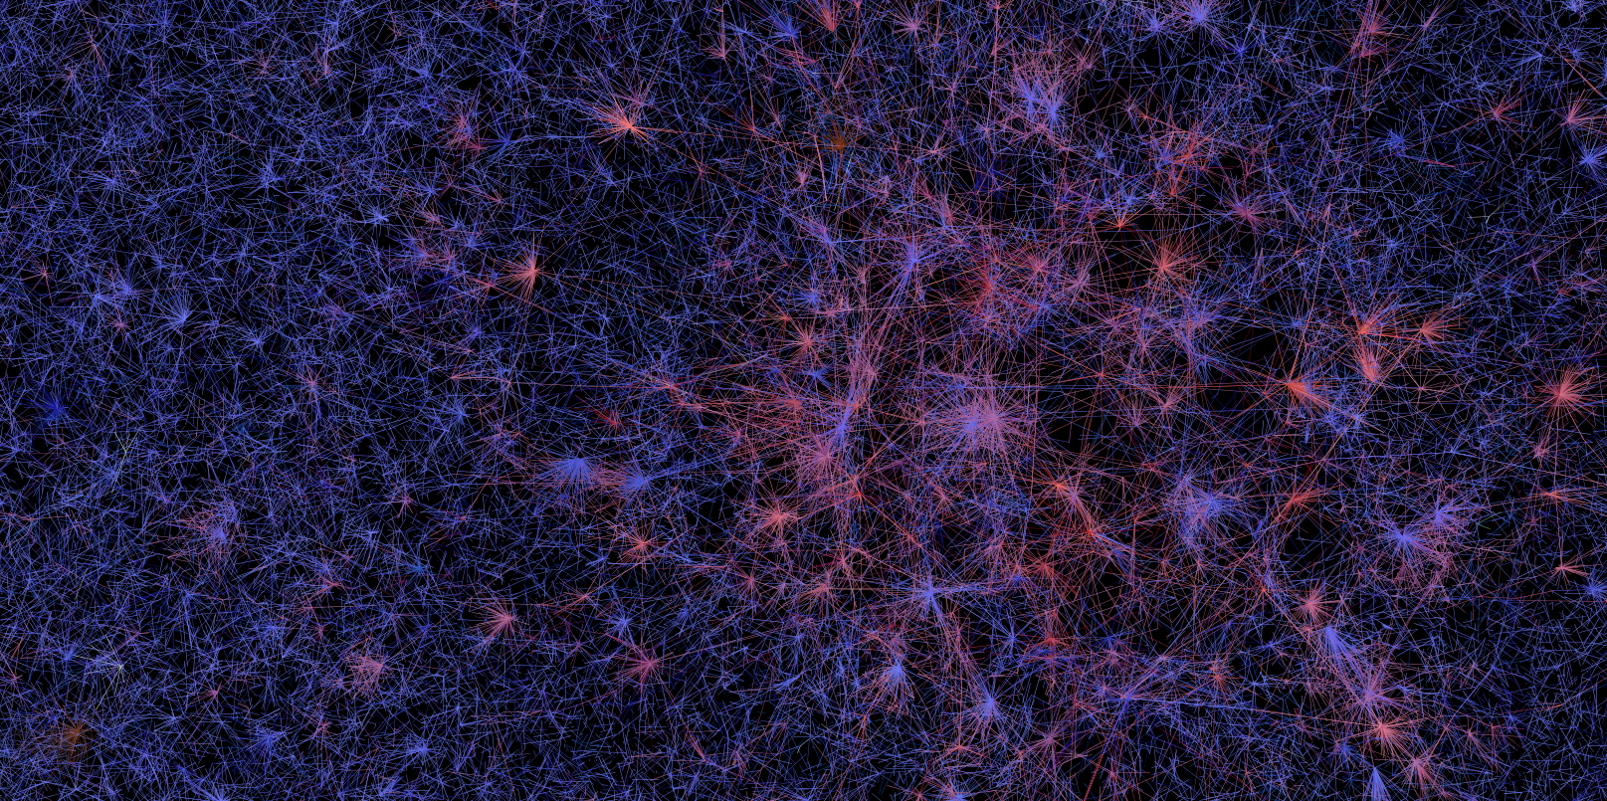

Slide 13

How large can $\left\|\tilde{π}−π\right\|$ be ?

Slide 14
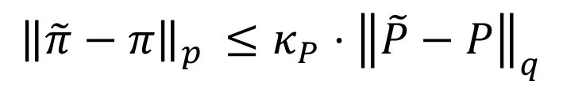



Weak bounds already exist
They depend more on the size than the structure of the network / perturbation
$${\left\|\tilde{π}−π\right\|}_{p }≤κ_{P}⋅{\left\|\tilde{P}−P\right\|}_{q}$$
Condition number of $P$
Sensitive mainly to the magnitude of the perturbation
But what if perturbations only affect a few rows of $P$ ?
Typically blows up when the network size grows
Unless ${\left\|\tilde{P}−P\right\|}_{q}$ vanishes
$$⟹$$
We need better, tighter bounds, adapted to local perturbations !

Slide 15
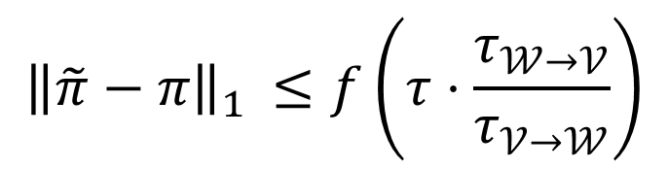


Como & Fagnani proposed a bound for the 1-norm
a nice increasing function
escape time from $𝒲$
$${\left\|\tilde{π}−π\right\|}_{1 }≤f\left(τ⋅\frac{τ_{𝒲→𝒱}}{τ_{𝒱→𝒲}}\right)$$
mixing time
hitting time from $𝒱$ to $𝒲$
Captures local perturbations
Provides physical insight
Difficult (impossible?) to extend to other norms
No reason to believe that it is tight

Slide 16





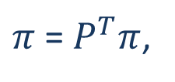





It is possible to compute the maximum of ${\left\|\tilde{π}−π\right\|}_{∞}$
Exactly and in polynomial time
1.
Compute $π$ from
$π$ = $P^{T}π$,
$$1^{T}π=1$$
2.
For all $v$, compute $\left|\min_{\tilde{P}}{{\tilde{π}}_{v}−π_{v}}\right|$ and $\left|\max_{\tilde{P}}{{\tilde{π}}_{v}−π_{v}}\right|$
$$Δ_{v}^{min}$$
$$Δ_{v}^{max}$$
$$\min_{\tilde{P}}{{\tilde{π}}_{v}}$$
$$π_{v}$$
$$\max_{\tilde{P}}{{\tilde{π}}_{v}}$$
$$Δ_{v}^{min}$$
$$Δ_{v}^{max}$$
3.
Return the largest $Δ$ encountered over all $v$’s

Slide 17



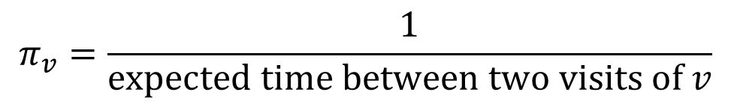
Finding $\max_{\tilde{P}}{{\tilde{π}}_{v}}$ is easy
$$v$$
probability 1
$$𝓦$$
$$π_{v}=\frac{1}{\text{expected} \text{time} \text{between} \text{two} \text{visits} \text{of} v}$$

Slide 18

Finding $\min_{\tilde{P}}{{\tilde{π}}_{v}}$ is easy too but…
$$v$$
probability 1
$$𝓦$$
$$π_{v}=\frac{1}{\text{expected} \text{time} \text{between} \text{two} \text{visits} \text{of} v}$$

Slide 19





Finding $\min_{\tilde{P}}{{\tilde{π}}_{v}}$ if we fix the escape time from $𝓦$
Let us add the constraint that $τ_{𝒲→𝒱}=T$
Furthest away from $v$
$$v$$
$$u$$
??
probability $1−p(T)$
probability $p(T)$
$$𝓦$$
$$π_{v}=\frac{1}{\text{expected} \text{time} \text{between} \text{two} \text{visits} \text{of} v}$$

Slide 20





A counter example
$$u$$
$$v$$
$$u$$
$$′$$
$$w$$

Slide 21
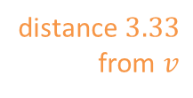
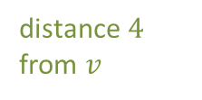
A counter example
distance $3.33$ from $v$
$$u$$
$$v$$
$$u$$
distance $4$ from $v$
$$′$$
$$w$$

Slide 22



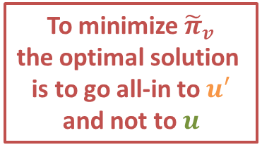
A counter example
distance $3.33$ from $v$
$$u$$
$$v$$
$$u$$
distance $4$ from $v$
$$′$$
probability $1−p(T)$
To minimize ${\tilde{π}}_{v}$
the optimal solution
is to go all-in to $u′$
and not to $u$
$$w$$
probability $p(T)$
$$⟹$$
We need to loop through every candidate “worst-node”…

Slide 23
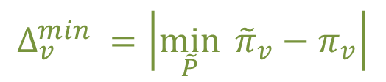




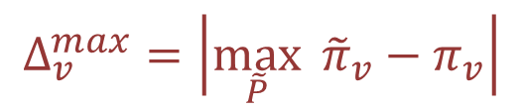


The algorithm to compute the maximum of ${\left\|\tilde{π}−π\right\|}_{∞}$
over all perturbations of the nodes of $𝒲$, under the escape time constraint $τ_{𝒲→𝒱}=T$
1.
Compute $π$ from
$π$ = $P^{T}π$,
$$1^{T}π=1$$
2.
For each $v,$ compute:
$$Δ_{v}^{max}=\left|\max_{\tilde{P}}{{\tilde{π}}_{v}−π_{v}}\right|$$
$1$ computation of ${\tilde{π}}_{v}$
all nodes of $𝒲$ go to $v$ with probability 1
$$Δ_{v}^{min} =\left|\min_{\tilde{P}}{{\tilde{π}}_{v}−π_{v}}\right|$$
$n$ computations of ${\tilde{π}}_{v}$
all nodes of $𝒲$ go to some node $u$ with probability $1−p(T)$
and stay in $𝒲$ with probability $p(T)$
3.
Return the largest $Δ_{v}^{min}$ or $Δ_{v}^{max}$ encountered

Slide 24
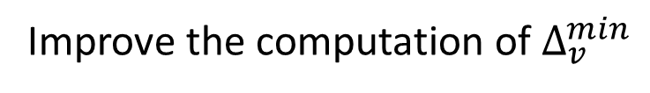
Perspectives
Improve the computation of $Δ_{v}^{min}$
by identifying the “worst-node” on the go, based on its distance to $v$
Extend the approach to other norms
especially the 1-norm
Compare the results with Como & Fagnani’s bound
to establish its quality

Slide 25
Thank you

